Slide 1


FINANCIAL STOCK MARKET REPORT
FOR DATALEUM HACKATHON
4.0 EDITION.
PRESENTED BY:
ODUMERU ADEOLA JULIET
SEPTEMBER 15, 2024

Slide 2

CONTENTS
01
INTRODUCTION TO THE STATEMENT
02
DATA ANALYSIS REPORT
03
RECOMMENDATION
04
CONCLUSION

Slide 3


OVERVIEW
BUSSINESS PROBLEM STATEMENT
As a Data Analyst the task is to conduct a comprehensive analysis and visualization of financial stock market price for various companies stock listed and the sector, the sector Health, Telecommunication play a major role buying and selling of their capital share and its dividend yield
The primary goals is to explore relationship and correlation among the key indication variable like High , Price , Price/Earning

Slide 4
FINANCIAL STOCK MARKET REPORT
The ability to forecast the stock market has become critical for organizing business operations. Many studies in a range of fields, including operations research, computer science, statistics, economics, and finance, have been motivated by the prediction of stock price. Recent research has demonstrated that the vast amount of publicly accessible online information, including news from the media, social media platforms, and Wikipedia, significantly influences investors' perceptions of the financial markets. Because the stock market is highly sensitive to changes in the economy and can cause financial losses, the accuracy of computer models used to predict it is crucial.
Stock Analysis help traders to gain an insight into the economy , stock market, or securities involving the past and present market data, also includes the identification of ways of entry into and exit from the investment..
Stock Market means equity market or share market is the aggregation of buyer and seller of shock called shares.

Slide 5
FINANCIAL STOCK MARKET REPORT
These may includes securities listed on public stock exchange as well as stock that is only traded privately such as share of private companies.
A financial stock market report is a written or published work that offers a synopsis and evaluation of the financial performance, stock market activity, and overall investment prospects of a company. Usually, it consists of:
Company overview: Overview of the company, its offerings, and its industry.
2. Financial statements: Analysis of the cash flow statement, balance sheet, and income statement.
3. Stock performance: Market capitalization, trading volume, and historical and present stock prices.
4. Valuation metrics: dividend yield, price-to-book (P/B) ratio, and price-to-earnings (P/E) ratio
.5. Growth prospects: Potential growth in revenue, earnings, and cash flow is examined
.6. Risk factors: Explaining possible dangers, difficulties, and ambiguities.

Slide 6
FINANCIAL STOCK MARKET REPORT
The financial datasets were made available for analysis; there were some adjustments made during the visualisation process, with 505 total stock market records. A relationship between the fact table and the dimension table was created by creating a fake date in place of the stock market date, after the data had been cleaned and transformed.

Slide 7
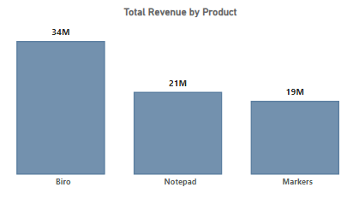
TOP 3 PRODUCTS BY REVENUE
There were 6 products in Office distributed across different states and Segment been sold.
Biro, Notepad and Markers, were the top 3 products by revenue.

Slide 8
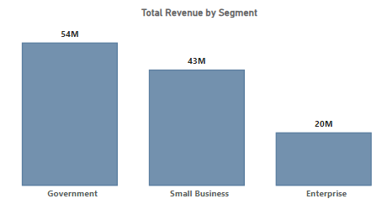
TOP 3 SEGMENT BY REVENUE
There were 5 Segment that purchased variety of office supply distributed across different states
Government, Small Business and Enterprise, were the top 3 Segment by revenue.

Slide 9
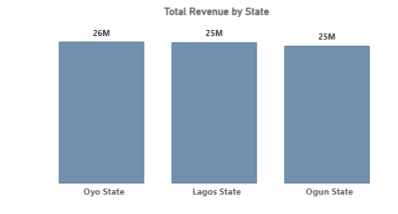
TOP 3 STATE BY REVENUE
There were 5 state that purchased office supply from different Segment.
Oyo, Lagos and Ogun, were the top 3 state by revenue.

Slide 10
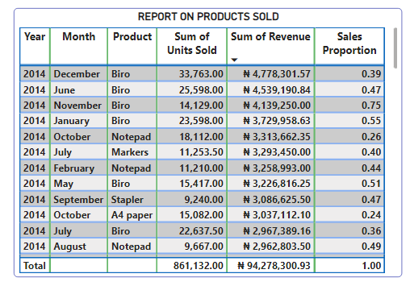
SALE PROPORTION ON PRODUCT SOLD
The sales proportion of products been sold for Y2014. Biro has highest revenue generated for four consecutive month of December, June, November, January with sum of N4.7M at 0.39%, N4.5M at 0.47%, N4.1M at 0.75%, N3.7M at 0.55% naira respectively.
Total revenue for Y2014 from January to December was N94M naira which is over 0.9% of the total revenue.

Slide 11
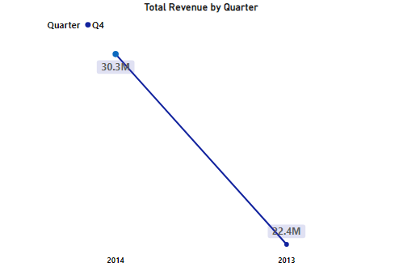
TOTAL REVENUE BY QUARTER
This depicts the revenue Quarter 4 for Y2014 and Y2013.
The revenue for the last quarter of Year 2014 was 30.3M naira while Year2013 was 22.4M naira this explain sharp increase of sales 2013 to 2014.

Slide 12
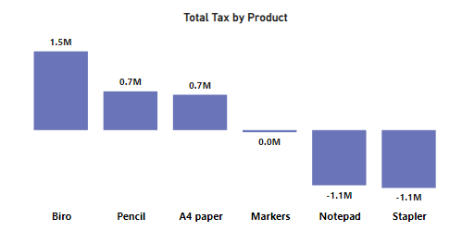
TOTAL TAX BY PRODUCT
The highest tax paid on products is Biro which also generated the highest revenue. This implies that there is a good returns on the investment.
Others products like Markers, Notepad and Staplers has lowest Tax paid.

Slide 13
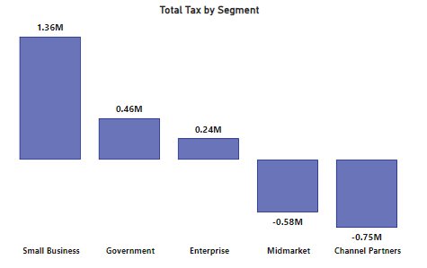
TOTAL TAX BY SEGMENT
The highest tax paid on segment is Small Business which also generated the highest revenue. This implies that Small Business pay more tax than Government.
Others Segment like Midmarket's and Channel Partners has lowest Tax paid they are not contributing much on tax.

Slide 14
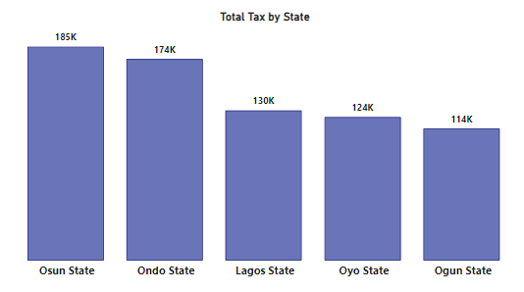
TOTAL TAX BY STATE
The highest tax paid on State is Osun state which generated the highest revenue while Ondo state paid more tax.
Oyo and Ogun state are favorably environment for business because they are less tax compared to the revenue.

Slide 15

CONCLUSION
There were 5 products which were distributed across different segments and states.
The key product driving performance are Biro, Pencil and A4 Paper .
Notepad and Stapler should be discontinued due to poor revenue and cost of production.
Osun state pays the highest tax on biro and biro contributed the highest tax in government among others segment.
Channel partners and Midmarket has lowest contribution on tax.
Comparing the last quarter of 2013 to 2014, there is increase in profit, sales and revenue over a period of time.

Slide 16


RECOMMENDATION
A4 paper, Stapler and should be pack in due to their poor performance and high cost of producing this products yields loss.
More investment should be added into Biro , Notepad and Markers because this brings in more profit and revenue
The tax system should be regulated because some products are paying more tax, while others are not paying.

Slide 17

THANK
YOU

